Slide 1
UNDERSTANDING SYSTEMIC CORRUPTION
Johan J Coetzee
13th Winelands Conference 2012

Slide 2
Problem situation
Corruption is a complex phenomenon with no simple explanation for its occurrence with various definitions, manifestations, mutations of its nature & with varied root ‘causes’ in & impacts on society

Slide 3
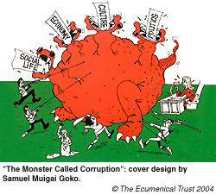
Problem situation
Corruption is systemically bonded in social processes becoming both the creator & consequence of a very complex & general problem situation of ingrained deviate social behaviour, making it a ‘cross-cutting issue’

Slide 4
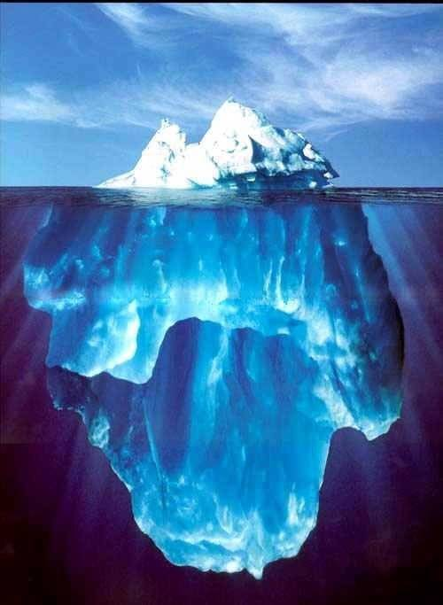
Corruption & organised crime
Nexus between systemic corruption, local organised crime, transnational organised crime & globalisation
Not only an inter-connectedness but also an inter-relatedness & an inter-dependency & subversiveness

Slide 5
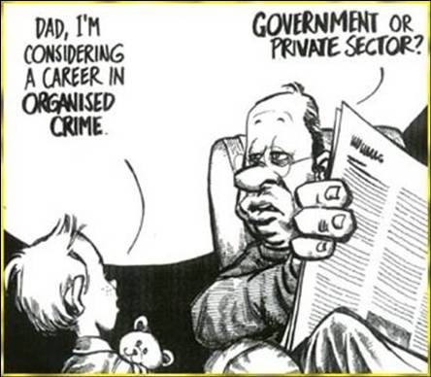
WB approaches to Corruption
1st definition - limited to public office, adjusted definition - in both public and private office, changed description to abuse of office for private gain
Still fails to acknowledge systemic nature of corruption

Slide 6
Approaches to Corruption
Systemic corruption vs ‘accidental corruption’ -corruption within sphere of individuals – demonstrates working of decision making systems, action systems & rule systems
Reference is sometimes made to ‘corruption as a culture’ & ‘corruption as a social pathology’.
Discourse about nature & impact of corruption focuses very strongly on its systemic nature. Evident in metaphors of cancer & HIV/AIDS

Slide 7
Objectives To…
  Specify nature & character of corruption
  Identify co-producers of corruption, their negative impacts on development
  Construct a conceptual framework for understanding systemic corruption

Slide 8
Methodology
Hermeneutics - interpretation of text
Conceptual analysis - contextualising
- definitions
- descriptions
Experiential

Slide 9
Research Framework
Systems dynamics
– for providing conceptual clarity
- idealised design & stakeholder planning approach Ackoff &
Gharajedaghi (key ‘practitioner-scholar’)
Complex systems/complexity
- to identify co-producers
- to dissolve problem situations
conceptual clarity & articulating
defining key concepts in addressing systemic problem situations

Slide 10
Concept clarification
Integrity
Corruption & systemic corruption
Development
Systems & systems concepts

Slide 11
Integrity
Corruption represents a breakdown in integrity
Integrity implies “honesty, probity, uprightness, moral soundness, moral stature, principle, character, virtue, purity”, Rose-Ackerman (1996: 2)
Antonyms of integrity are “deceit, venality, corruption”, Reader’s Digest Family Word Finder (2006: 447)
Latin for ‘integrity’ is in-teger, meaning “what is not touched, taken away from, or interfered with”, as cited by Stanford Encyclopedia of Philosophy (2010)

Slide 12
Integrity
In-teger, can be interpreted as ‘wholeness’
Therefore, ‘integrity’ should be a central (albeit contrasting) concept in any root definition of corruption, because it represents consistency in “actions, values, methods, measures, principles, expectations & outcome”, as cited by Stanford Encyclopedia of Philosophy (2010)
As a holistic concept, it judges the quality of a system (e.g. a society) in terms of its ability to achieve its own goals

Slide 13
Corruption
Corruption can be defined as:
“…an impairment of integrity, virtue or moral principle; depravity, decay,
&/or an inducement to wrong by improper or unlawful means,
a departure from the original or from what is pure or correct,
&/or an agency or influence that corrupts”, cited by the, Merriam-Webster Dictionary (2010)

Slide 14
Corruption vs Integrity
Corruption is the antithesis of integrity, Spies (2003: 9) because a breakdown of integrity means a systemic breakdown
This systemic contamination affects the cohesion of & symbioses in a social system, it is also a direct attack on the norms & standards as 1 of 5 drivers of such cohesion & symbioses
Corruption is symptomatic of a society in which serious systemic imbalances occur, Spies (2003: 9)

Slide 15
Systemic corruption
Multi-dimensional
Not “just a malfunctioning of the value system” (moral)
but a 2nd-order-obstruction of a social system, that include :
generation & distribution of power (political), wealth (economical), knowledge (scientific & technological), peace & harmony (morality & spirituality) & inspiration & hope (aesthetics)
Corruption can’t be defined properly if general conditions under which it occurs are not described

Slide 16
Systems
“…a whole defined by one or more functions, that consists of two or more essential parts”, satisfying conditions as follow:
“Each of these parts can affect the behaviour or properties of the whole;
None of these parts has an independent effect on the whole;
The way an essential part affects the whole depends on what other parts are doing; &
Every possible subset of the essential parts can affect the behaviour or properties of the whole but none can do so independently of the others”, Ackoff as cited by the WWW (2009: 6)

Slide 17
Development
Development of social system described as a learning & creative process
“by which a social system increases its ability & desire to serve its members & its environment by the constant pursuit of truth, plenty, good, beauty & liberty”, Ackoff as cited by Gharajedaghi (1982: 54)

Slide 18
Systems concepts
Poverty
Complex systems
Culture
Development

Slide 19
Types of systems
Unminded brainless direct cause & effect 17th century war
Uniminded biological/organismic systems & centrally controlled institutions silo effect isolation profit at all cost
Multi minded social system climate/context for change must be created social consciousness sustainable & durable institutions intolerance for corruption

Slide 20
Co-producers
Consist of 1st& 2nd-order-obstructions to development
Obstructions represent 5 dimensions of human aspirations
In exploring drivers of human behaviour questions are answered as to why people strive for: -
- economic well-being? - economics (e)
- power/influence? - politics (p)
- knowledge? - knowledge/s/t (k)
- morality/ethics? - morality (m)
- innovation/creativity? – aesthetics (a)

Slide 21
Co-producers
Conflicting human aspirations obstructing development (1st order obstructions) include:
- Poverty vs wealth - e
- Ignorance/incapability vs knowledge & skills - k
- Minority vs majority - p
- Elitism vs populism - k
- Discrimination vs indiscrimination - e
- Nihilism vs moral governance - p
- Sense of belonging vs isolationism - a
- Innovation vs boredom - a

Slide 22
Co-producers
When more than 1-1st order obstruction interact, it produce 2nd order obstructions:
- alienation
- polarisation
- terrorism
- corruption

Slide 23
Five dimensional design

Slide 24
Impact on development
Corruption impact on:
Resource unlocking
Institutional integrity & trust
2ndary development (quality/sustainable)
Cultural integrity
Moral leadership
Good governance
Co-produce increased complexity:
More obstructions created, higher probability of interaction, more severe impact would be & more complex to dissolve

Slide 25
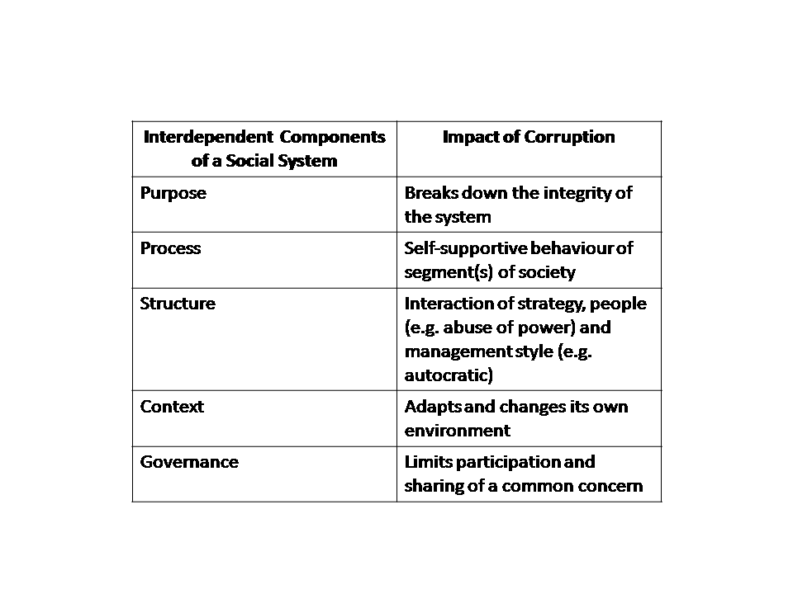
Impact of corruption on social system

Slide 26
2nd Order Obstructions
Every dimension of social system has 1st order obstructions - Emergent I properties
1st Order obstructions interact & resonate to more complex level of 2nd order obstructions – Emergent II
Each subsystem can co-produce 2nd order obstructions developing a mess/knot of sets of problems
Knots can’t be solved - n0 cause effect exists
Knots are not a sum of parts - efficiency of parts does not improve efficiency of whole system

Slide 27
2nd Order complexity
Change in 1 or more components of system can have unpredictable outcomes, Emergent II properties
Outcomes can be contradictory & counter-intuitive
Outcomes unexpected/unplanned/unmanageable
2nd Order obstructions can’t renew/change/improve itself
Corruption strengthens corruption
History of corruption develops that created vicious cycles reinforced by negative recurring behaviour

Slide 28
Dimensions of complex systems
Governance
Purpose
Structure
Context
Processes

Slide 29
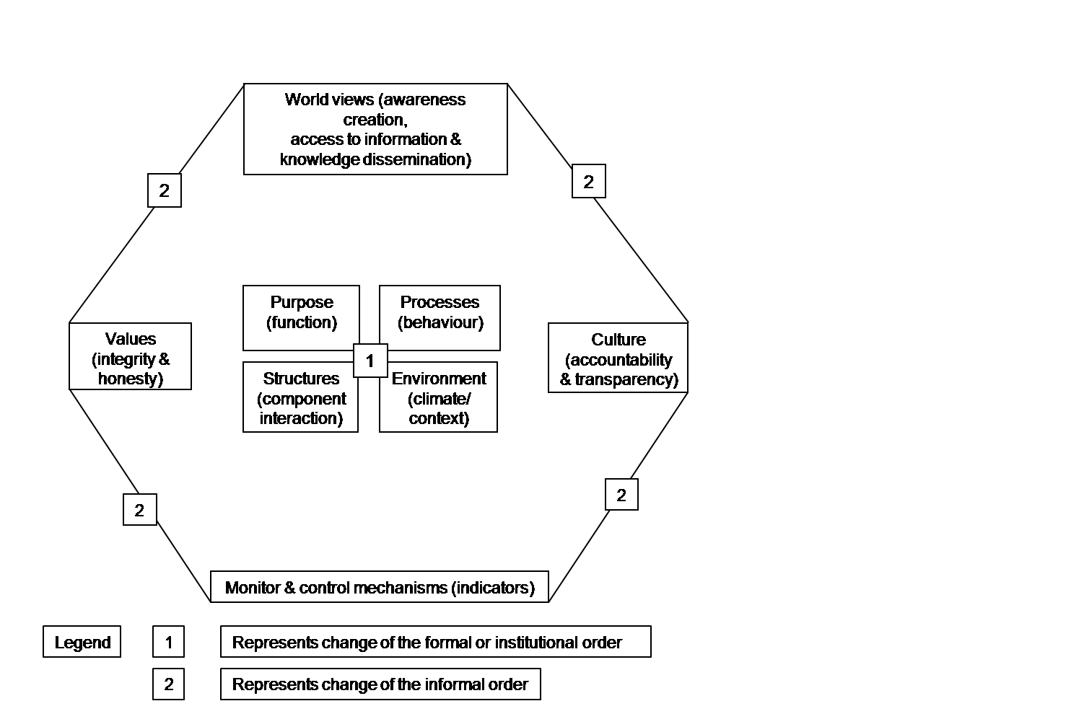
Dissolving complex systems

Slide 30
Dissolving corruption
Multi-disciplinary problem situation & multi-disciplinary approach for addressing cross-cutting issues e.g. poverty development & corruption
Convergence of integration (jell) and differentiation (specialisation) for sustainable development
Create environment conducive for new & sustainable culture
Structural - change interactions of components (millions)
Blending hard & soft/formal & informal approaches & strategies
Balancing 5 dimensions of complex systems
Closing gaps e.g. knowledge/science/techno vs unknown spirituality
Human behavioral changes – increase flow of info; motivation & penalties; risks & rewards’; culture & power
Inspiring innovative creative a marketable ‘cool’ strategies for leveraging of perceptions & propensities for systemic outcome

Slide 31
Dissolving corruption
Scenario planning
For change management strategies, identify:
Key drivers e.g. motivation & commitment & citizen involvement/investment to develop social consciousness
Key uncertainties how parts of system interact & respond to change strategies e.g. increased policing vs illegitimate political system
Key interventions/ leverage points e.g. Police Inland Revenue Parliament Procurement
National Integrity Systems for building trust – TI e.g. 11 pillars of Greek Temple
Institutionalising personalising & tailoring universal ethical values to meet subculture differentiation and convergence e.g. development
Common denominators of comparative best practices USA & UK, HK & Singapore reforms

